Slide 1
Intelligence in Biological Systems II Project
By Sivamaran.M.AC

Slide 2
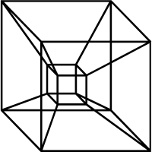
Tesseract

Slide 3
What is a tesseract?
Four-dimensional analogue of a cube (hyper cube)
Consists of 8 cubical cells

Slide 4
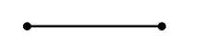
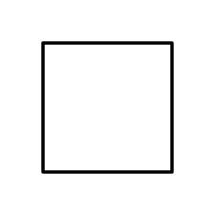
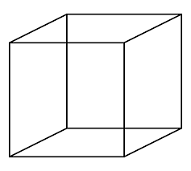
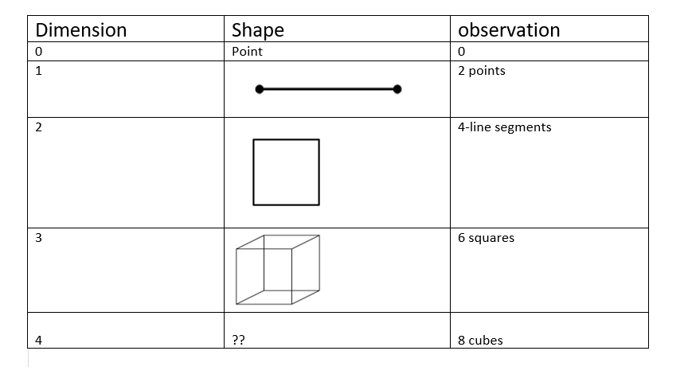
Let us observe a pattern

Slide 5
Can we visualize 4th dimension?
it's considered space-time in abstract mathematics and physics
In reality humans are incapable of visualizing in 4d
4D is not intuitive
4D being space-time is still a theoretical concept
Exaggerated in sci-fi movies

Slide 6
Can we mathematically represent 4d space?
Yes, it can be easily done using linear algebra
Vector of length n represents exists in n-dimensional space
In linear algebra there is no constraint on the number of dimensions

Slide 7
How do we visualize in 3rd dimension?
We perceive the 3D world through our eyes
The images we see are made up of light reflected from the objects we look at
Light enters the eye through the cornea
The real image is projected onto light sensitive retina at the back of the eye
An upside image is formed
The brain inverts the image and combines images from both eyes , then adds perception of depth

Slide 8


Stereographic projection
In geometry, the stereographic projection is a particular mapping (function) that projects a sphere onto a plane.
A n-sphere is mapped to n−1 dimensions

Slide 9
projection
a projection is a mapping of a set (or other mathematical structure) into a subset (or sub-structure)
Casting a shadow onto a plane
It is extensively used in linear algebra
Has applications in machine learning algorithms and Principal component analysis

Slide 10
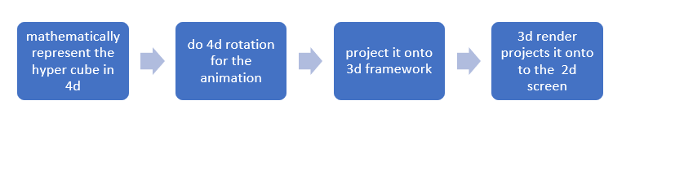
Methodology

Slide 11
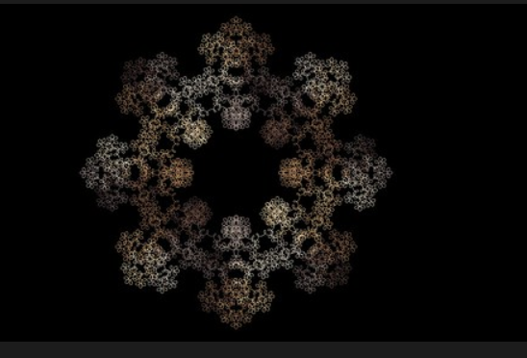
Fractal Spirographs

Slide 12
What are fractal spirographs?
Fractal Spirographs (aka Fractal Routlette) are generated by tracking a series (or chain) of circles rotating around each other
Changing the number of circles, the size ratio between circles, the speed of angle change, and the constant “k” changes the resulting plots and images

Slide 13
Chaos Game

Slide 14
What is chaos game?
chaos game originally referred to a method of creating a fractal, using a polygon and an initial point selected at random inside it.
The fractal is created by iteratively creating a sequence of points, starting with the initial random point, in which each point in the sequence is a given fraction of the distance between the previous point and one of the vertices of the polygon
Repeating this iterative process a large number of times, selecting the vertex at random on each iteration
Using a regular triangle and the factor 1/2 will result in the Sierpinski triangle,

Slide 15
Steps
Fix three points in the plane, C1, C2 and C3. For definiteness, we take the points C1 = (0, 0), C2 = (1, 0) and C3 = (0.5, √3/2), the corners of an equilateral triangle.
Pick any point P₀ and draw a dot there. This is our starting point. At each stage, we denote the current point by P_{k} and call it the game point.
Roll the dice. If n comes up, draw a point half way between P_{k} and C_{n}. For example, if we roll a 2, we pick the point half way between the current point Pk and C₂. This is the new game point.
Repeat this procedure many times, drawing a new point at each step.

Slide 16
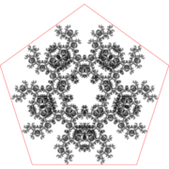
A point inside a pentagon repeatedly jumps half of the distance towards a randomly chosen vertex, but the currently chosen vertex cannot be the same as the previously chosen vertex.

Slide 17
Thank you!!

